Slide 1
BIGTECHCOMPANY
Financial Overview
By Wambui Gitahi

Slide 2
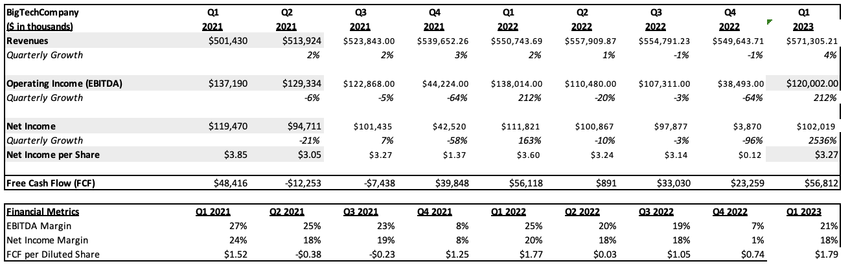
QUARTERLY PERFORMANCE

Slide 3
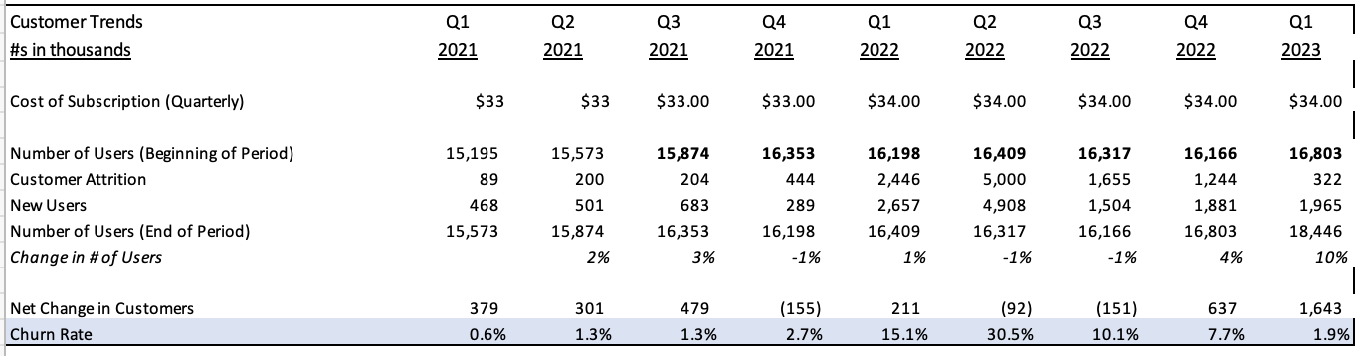
CUSTOMER TRENDS
Key Takeaways:
The increase in price caused an increase in customer attrition. However, a year after the price change, the customer attrition decreased.
The churn rate increased after the increase in price with the highest rate in Q2 2022.
Customer numbers are increasing. The change in users fluctuates, but significantly increased in Q1 2023.

Slide 4
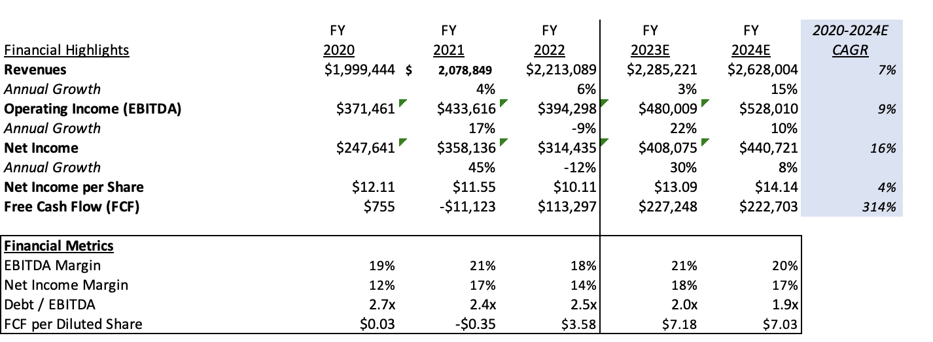
PROJECTIONS

Slide 5
CONCLUSIONS
For company highlights, please compose bullets on the following:
The company’s historical and future revenue trends.
The company’s cash flows.
The company’s debt/EBITDA in comparison to the industry average (4.0x) – Note a low debt/EBITDA ratio is considered healthy.
Any other positives from the company’s financials.
For areas of concern, please compose bullets on the following:
The regularity of the company’s earnings – are they steady, decreasing, increasing, or volatile every quarter?
The company’s expenses and if there were any quarters where expenses were abnormally high in comparison to other quarters.
The company’s EBITDA margin in comparison to the industry average of 39%. Note, the higher the EBITDA margin, the better.
For the recommendation, write 1-2 bullets on if they should develop a relationship with Stargaze. Also include any areas that you should clarify with the company. For example, “We should ask the company to provide an explanation for the increase in revenues during this period.”
Delete this box once this step is completed.
Company Highlights
The company’s quarterly growth has been fluctuating between 2-3% with a decrease in growth from Q2-Q4 of 2022.
The company’s future quarterly growth is estimated to be 6% in Q2 2023.
The Debt-to-EBITDA ratio is below 3 and decreasing each quarter.
Areas of Concern
EBITDA Margin of >20%, except at the end of Q4 in 2021 and 2022. This is below the industry average of 39%.
Net Income Margin is relatively high, except at the end of Q4 in 2021 and 2022 when it is very low.
Recommendation
We should develop a relationship with Stargaze because the company’s historical data on revenues is relatively consistent and is projected to increase in the future from Q2 2023.
The company also has good Debt-to-EBITDA ratio.
We should ask the company to provide an explanation for the low profits at the end of the final quarter of each year.

